Slide 1
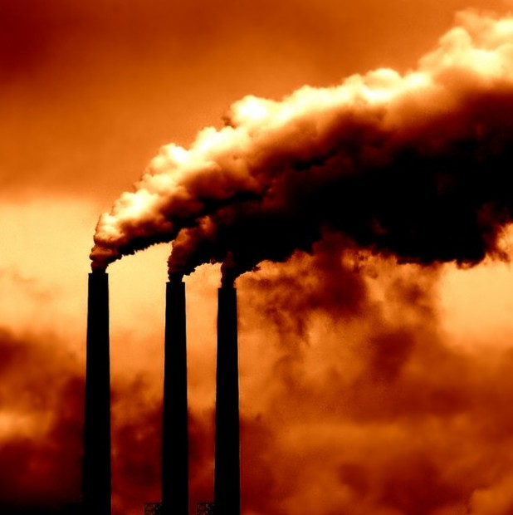
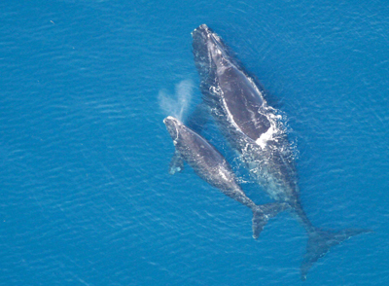
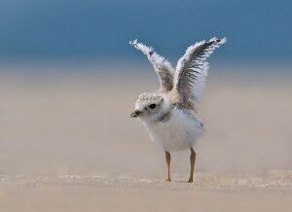
NWF & Offshore Wind Power

Slide 2
Offshore: A booming Global Industry
~ 14,000 MW installed
~ 85,000 jobs (coastal & inland)
$30B investment in 2016 (↑40%)
Europe: Dramatic Cost Reductions
50% cost reduction in last 5 years, 22% just last year
Now cost-competitive w/new nuclear & coal
Cost reductions much faster than industry projections
Clear, long term market + mature supply chain
LIPA selected a 90MW offshore wind project, citing it as the most cost-effective option which competed with fossil fuel
MA Deepwater Tesla proposal

Slide 4
Status of U.S. Atlantic Offshore Wind Power Development
America’s first project came online in 2016!
Block Island Wind Farm – 30 MW (RI)
Nearly 2 million acres of federal waters have been designated for offshore wind leasing:
8 Wind Energy Areas finalized
(MA, RI, NY, NJ, DE, MD, VA, NC)
Additional areas in process (NY, NC, SC)
7 companies now hold leases along coast with combined potential of >20 GW
State Market Policy Commitments
MA: 1,600 MW by 2027 (1st RFP due 6/17)
NY: 2,400 MW by 2030 (+90 MW project)
NJ: 1,100 MW (with 3,300 MW pledge)
MD: ~250 MW
RI: 150 MW

Slide 5
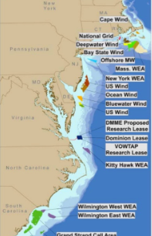

Slide 6
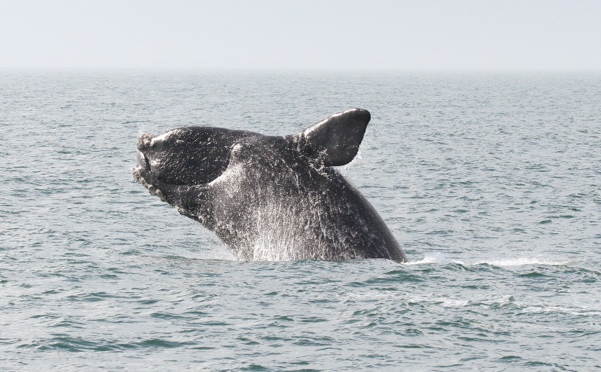
NWF’s Campaign for Atlantic Offshore Wind Power
Connect national, regional, state, & local offshore wind advocates
Demonstrate support from diverse voices to Governors/state leaders, federal Administration, & Congress
Advocacy to ensure wildlife protections during offshore wind siting, construction & operations
Rapid response & social media communications/outreach strategy

Slide 7
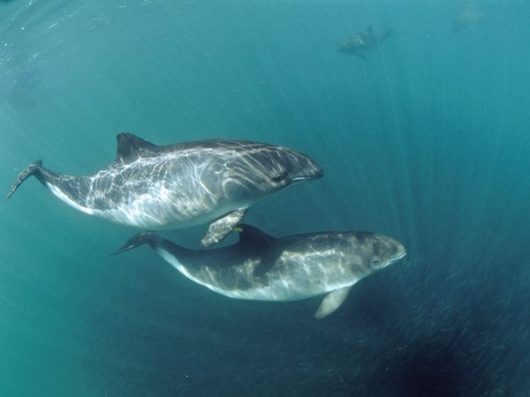
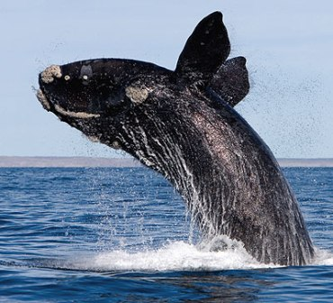
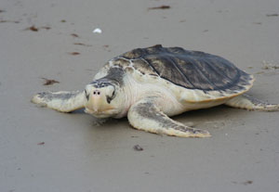
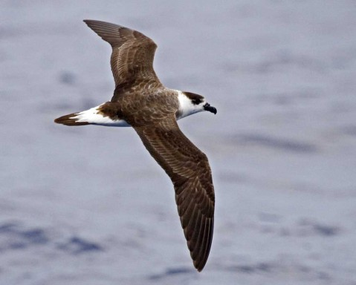
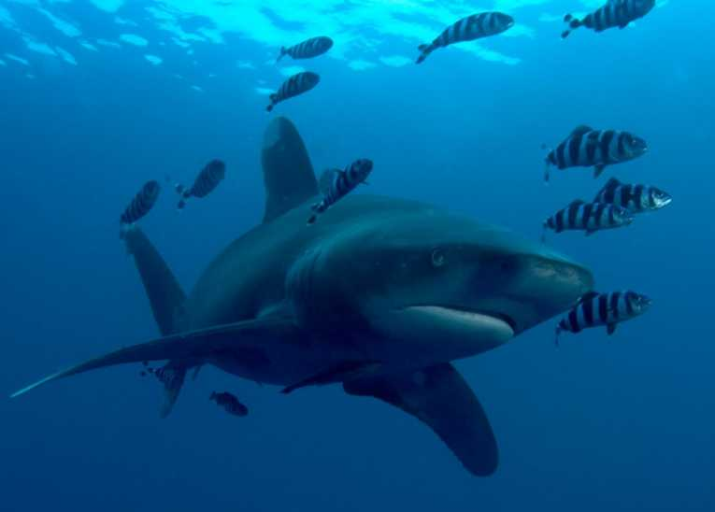
Environmental concerns across a range of species and habitats
Species concerns
Vessel collisions
Noise from pile driving
Short and potential long-term displacement from important habitat
Cumulative impacts
Habitat concerns
Benthic habitat loss and/or modification
Changes in turbulence and structure of the water column (prey base?)

Slide 8
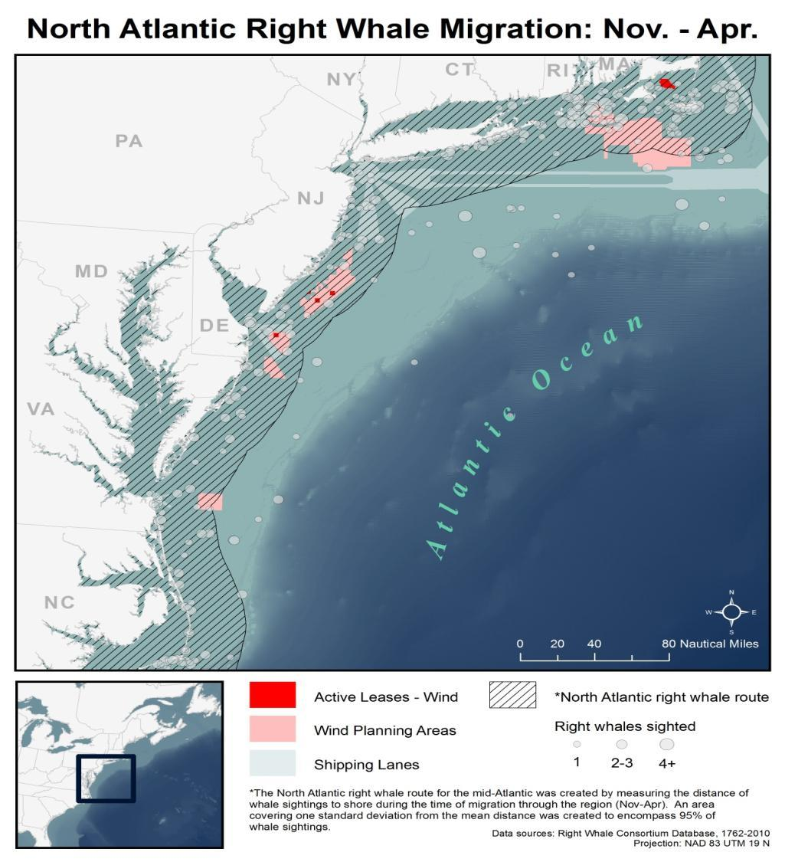
Working collaboratively to meet these challenges: Developing NARW mitigation measures
The NARW’s limited range directly overlaps with a number of WEAs:
Northeast seasonal foraging
Mid-Atlantic migration
Southeast calving habitat
Map: New England Aquarium

Slide 9
Working collaboratively to meet these challenges: Developing NARW mitigation measures
Goal: develop mitigation measures to protect the North Atlantic right whale while facilitating activities related to offshore wind energy development
Strategies:
-Most effective mitigation for NARWs is to separate development activity from animals
-Special attention to moms and calves
Scope:
-First phase of development: site characterization and assessment (e.g. some mid-Atl, RI/MA WEAs)
-Second phase of development: construction (e.g. Block Island)

Slide 10
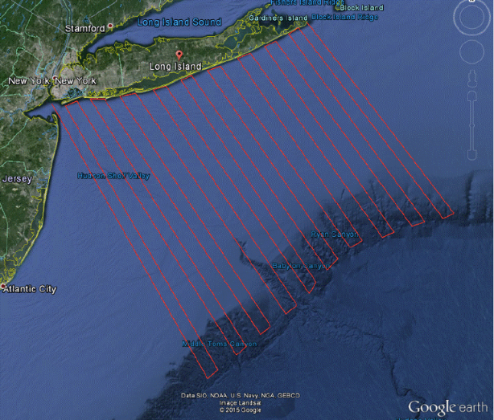
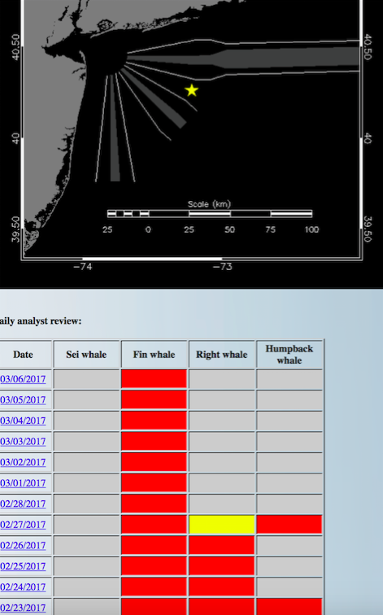
Important considerations and solutions
Data gaps in species distribution
Consideration & integration of multiple data sources (e.g. BOEM/MA CEC data, potential for NY)
Recommendations on environmental baselines (e.g. Nowacek et al. 2016)
Data & BMPs needed for other species, particularly resident populations
Little data on the impacts of OW on marine species
Precautionary operating conditions based on best available science
Adaptive management, with monitoring & data sharing
New technologies to reduce noise/impacts at the source
Antunes et al. submitted, Marine Mammal Science

